Slide 1
Product domain study
LINKEDIN ARTICLE:
ARTICLE:
CONCLUSION
The Smart Cooker Whistle Counter with Automatic Switch-Off is a new game-changer in the world of cooking, bringing convenience, precision, and safety into the cooking process. The automation of whistle counting and controlling heat allows one to avoid the risk of overcooking and minimize energy wastage. With this product, busy households and individuals can be assured of a safer way of cooking in just less time and effort. With its user-friendly design and enhanced functionality, it is poised to revolutionize the way we cook, offering a perfect blend of technology and practicality for every kitchen.

Slide 2
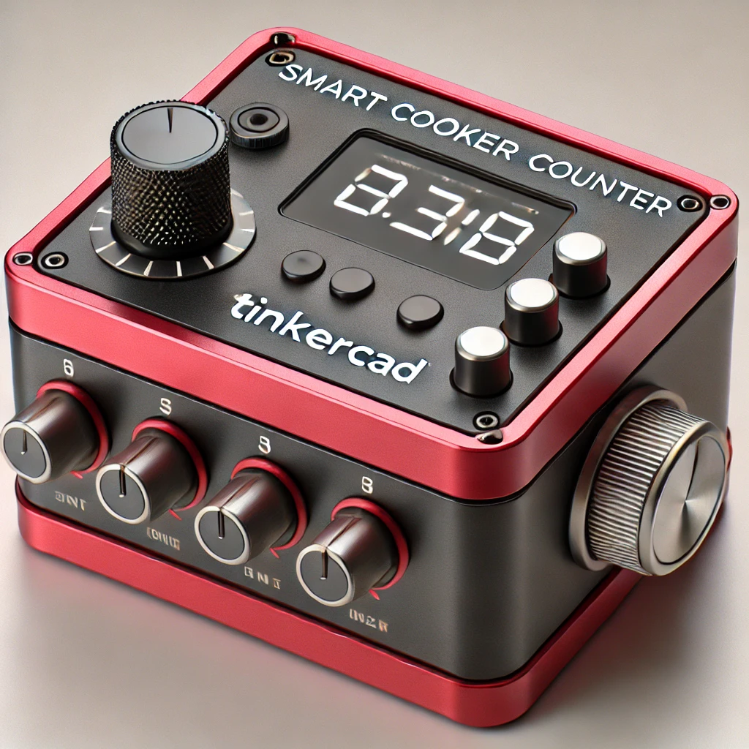
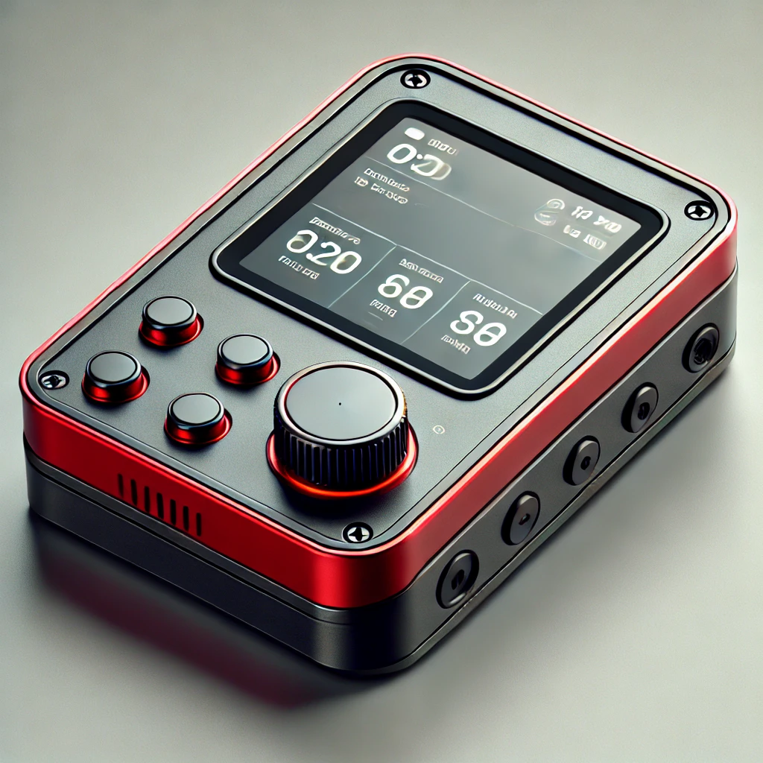

Slide 3
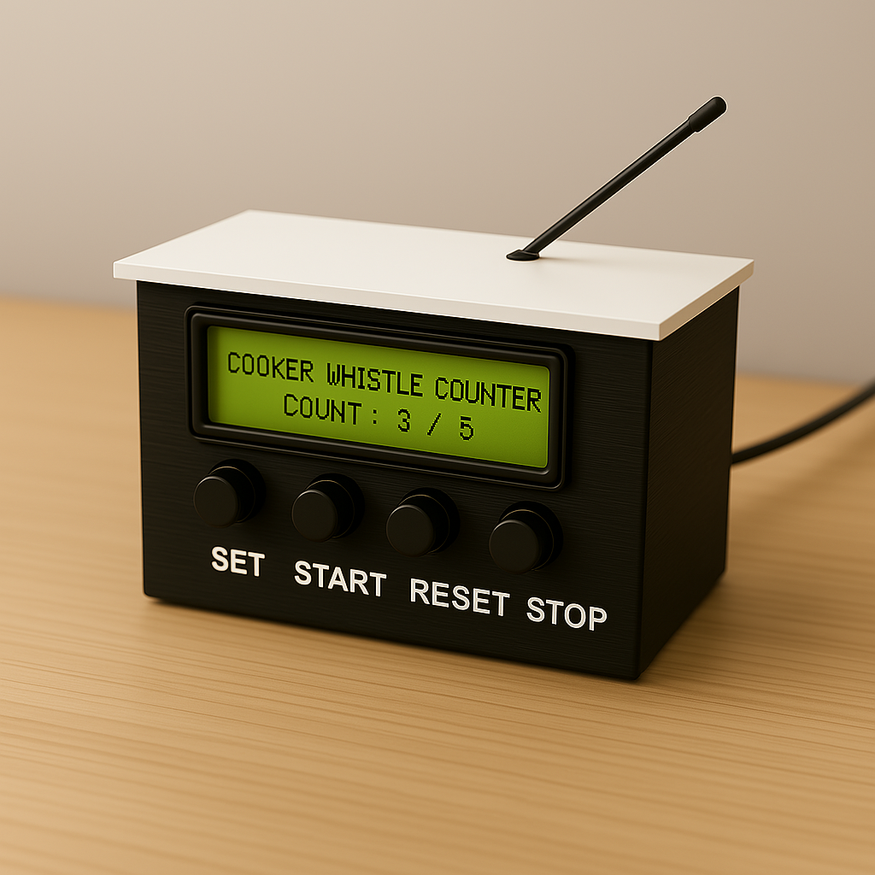
So;ution:
For accurate detection of whistles, sensors that are high-grade with noise cancelation and artificial intelligence-based processing can detect whistles independent of background noises. Compatibility with a variety of pressure cookers and stoves types is made necessary by variable sensitivity settings and multiform smart adapters. Reliability and safety would be enhanced with dual-sensor confirmation, synthesizing vibration sensing and audio detection to avoid misfires. Complications arising with power and connectivity are alleviated with battery backup and offline connectivity to ensure operation at all times.

Slide 4
The Smart Cooker Whistle Counter with Auto Shut-Off is a compact device designed to accurately count cooker whistles using advanced audio and vibration sensors. Once the preset number of whistles is detected, it automatically shuts off the stove using a relay, ensuring perfect cooking every time—without constant monitoring.
Solution:
High-quality sensors utilizing noise cancellation and AI algorithms can reliably detect whistles even in noisy environments. Adjustable sensitivity and smart adapters ensure compatibility with different types of pressure cookers and stoves. Dual-sensor technology, integrating vibration and sound detection, enhances reliability and reduces false alarms. An intuitive user interface and easy setup process will encourage greater user adoption and satisfaction.

Slide 5
Product Problem:
A Smart Cooker Whistle Counter with Auto Shut-Off faces challenges like accurate whistle detection due to background noise, requiring advanced sensors. Compatibility issues arise with different pressure cookers and stove types, demanding adaptable designs. Safety concerns include false shut-offs, necessitating dual-sensor verification for reliability. Power supply and connectivity limitations may affect performance, so offline functionality and manual override options are essential. Market acceptance depends on user-friendly interfaces and educating consumers about the benefits of automation in cooking.
Solutions:
High-quality sensors utilizing noise cancellation and AI algorithms can reliably detect whistles even in noisy environments. Adjustable sensitivity and smart adapters ensure compatibility with different types of pressure cookers and stoves. Dual-sensor technology, integrating vibration and sound detection, enhances reliability and reduces false alarms. An intuitive user interface and easy setup process will encourage greater user adoption and satisfaction.

Slide 6
Problem Statement
Traditional pressure cookers require constant attention to count whistles and manually switch off the heat, which can result in overcooking or burning food. This process is time-consuming and increases the risk of accidents. For individuals with busy schedules, it becomes difficult to monitor cooking while managing other tasks. Therefore, there is a need for a smart cooker that automatically counts whistles and turns off the heat, ensuring precise cooking and enhanced safety.The absence of automation in whistle counting also makes it difficult for individuals with busy schedules or disabilities to monitor cooking effectively. A smart system integrating sensor-based whistle detection and auto shut-off can enhance efficiency, reduce manual effort, and promote energy conservation.

Slide 7

User Persona 1
6.Problem Statement :
Lokesh, an undergraduate student, often struggles to manage cooking while focusing on his studies and other tasks. Traditional pressure cookers require constant supervision, making it stressful and time-consuming. A Smart Cooker Whistle Counter with Auto Shut-Off would help Lokesh cook safely and efficiently without needing to monitor whistles, allowing him to focus on his academics and relax with peace of mind.
7. Goals & Needs:
Needs a smart cooking assistant that reduces manual effort.
Prefers an automated system that ensures consistent food quality.
Wants an energy-efficient and safe cooking solution.
8. Frustrations
Constant need to monitor the cooker manually leads to stress and distraction during multitasking.
Fear of overcooking or forgetting to switch off the stove causes anxiety, especially during busy schedules.
Lack of automation in traditional cooking methods limits the user’s ability to relax or focus on other tasks, resulting in mental fatigue.
9. Behavior Patterns:
Prefers quick cooking methods due to a busy lifestyle.
Actively researches and adopts new tech-based solutions.
Shares experiences and reviews on online forums and social media.
1. Name: Lokesh
2. Age: 25 years
3. Occupation: Embedded Systems Engineer
4. Education: Bachelor's Degree in Electronics and Communication Engineering (ECE)
5. Hometown: Bengaluru, India

Slide 8

User Persona 2
8.Frustrations
Difficulty in motivating users to consistently use the whistle counter feature while cooking.
Ensuring that the device accurately counts whistles according to different cooking styles and pressure levels.
Users may perceive the whistle counter and auto switch-off feature as complicated or unnecessary, reducing trust in the device’s automation.
10. Behavior Patterns:
Regularly uses smart gadgets at home, especially for cooking and cleaning.
Looks for YouTube reviews and tech blogs before purchasing new kitchen appliances.
Often recommends useful smart kitchen products to friends and family.
6. Problem Statement:
Ananya, a 23-year-old home cook, wants a reliable smart cooker whistle counter with an automatic switch-off feature that helps him cook perfectly without constantly monitoring the cooker. He needs a device that accurately counts whistles and safely turns off the cooker to prevent overcooking or accidents, making cooking easier and stress-free.
7. Goals & Needs:
Needs a smart cooker that tracks whistle count for perfect pressure cooking.
Looks for a user-friendly device that prevents overcooking and saves time.
Wants a solution that is portable, safe, and budget-friendly for everyday use.
Name: Ananya
Age: 23 years
Occupation: IoT Product Developer
Education: Bachelor’s Degree in Electronics and Communication Engineering (ECE)
Hometown: Hyderabad, India

Slide 9
8. Pain Points:
Often gets distracted while cooking, leading to overcooked or undercooked meals.
Finds traditional cookers outdated and inefficient.
Prefers a solution that integrates with smart home automation.
9. Motivations:
Interested in smart technology solutions for everyday tasks.
Values convenience, efficiency, and safety in the kitchen.
Prefers user-friendly and tech-enhanced home appliances.
10. Behavior Patterns:
Prefers quick cooking methods due to a busy lifestyle.
Actively researches and adopts new tech-based solutions.
Shares experiences and reviews on online forums and social media.
User Persona 1
6. Background & Lifestyle:
Works in an IoT-based startup, specializing in automation solutions.
Loves experimenting with smart home technologies.
Prefers quick and efficient cooking due to a busy work schedule.
7. Goals & Needs:
Needs a smart cooking assistant that reduces manual effort.
Prefers an automated system that ensures consistent food quality.
Wants an energy-efficient and safe cooking solution.
1. Name: suresh
2. Age: 25 years
3. Occupation: Embedded Systems Engineer
4. Education: Bachelor's Degree in Electronics and Communication Engineering (ECE)
5. Hometown: Bengaluru, India

Slide 10
User Persona 2
8. Pain Points:
Misses the exact whistle count while multitasking, affecting food taste and texture.
Struggles with manual monitoring of pressure cookers. Dislikes kitchen tools that lack automation or notification features.
9. Motivations:
Excited by the idea of hands-free, automated cooking.
10. Behavior Patterns:
Regularly uses smart gadgets at home, especially for cooking and cleaning.
Looks for YouTube reviews and tech blogs before purchasing new kitchen appliances.
Often recommends useful smart kitchen products to friends and family.
6. Background & Lifestyle:
Works as a home appliance technician at a consumer electronics company.
Passionate about integrating daily tasks with smart technology.
Lives in a shared apartment and prefers simple, automated cooking after work.
7. Goals & Needs:
Needs a smart cooker that tracks whistle count for perfect pressure cooking.
Looks for a user-friendly device that prevents overcooking and saves time.
Wants a solution that is portable, safe, and budget-friendly for everyday use.
Name: Ananya
Age: 23 years
Occupation: IoT Product Developer
Education: Bachelor’s Degree in Electronics and Communication Engineering (ECE)
Hometown: Hyderabad, India

Slide 11
Competitive Analysis
Competitor Name | Price | Target Audience | Unique Value Proposition | Components | Component Price
Whistle Track Pro | ₹ 3,500 | Home Cooks, Chefs | High-accuracy whistle detection with mobile app sync. | Microphone Sensor, Buzzer, LCD Screen | ₹ 1,200
CookSense Mini | ₹ 2,800 | Small Families | Compact design with LED alerts for whistle counting. | Sensor, Buzzer, Switches | ₹ 900
Auto Whistle Max | ₹ 4,200 | Restaurants, Hotels | AI-based whistle tracking with customizable alerts. | Relay Module, Microphone Sensor, LCD Screen | ₹ 1,500
Smart Cooker Whistle Counter | ₹ 2,500 | Home Users, Cooking Enthusiasts | Affordable, easy-to-use, and ensures perfect cooking every time. | Relay Module, Microphone Sensor, Switches, Buzzer, LCD Screen | ₹ 1,100

Slide 12
Competitor Type | Location | Product Offering | Cost (in ₹) | Website | Business Size
Direct | India | Smart Pressure Cooker with Digital Timer | ₹4,000–₹7,000 | www.smartcook.in | Medium
Indirect | China | Electric Pressure Cookers with IoT Features | ₹6,000–₹12,000 | www.iotcook.cn | Large
Direct | USA | Auto Shut-Off Attachments for Gas Stoves | ₹3,000–₹6,000 | www.kitchensmarttech.com | Small
Indirect | India | Manual Stove Timers and Whistle Counters (non-auto) | ₹800–₹1,500 | www.cookingtools.in | Medium

Slide 13
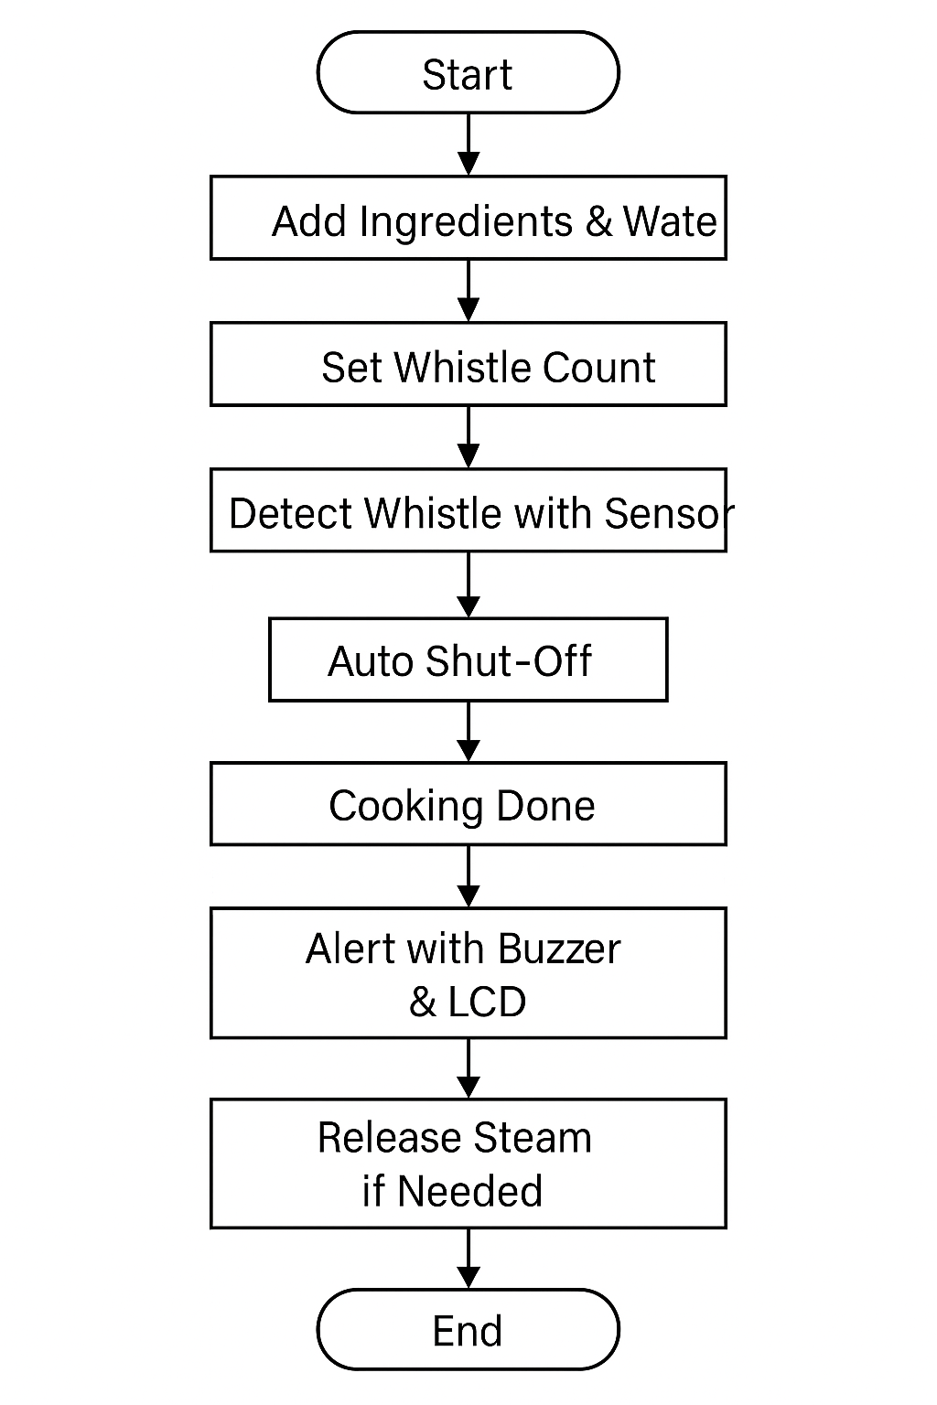

Slide 14
Interaction Analysis
Accessibility | User Flow | Navigation | Visual Design | Brand Identity | Tone | Descriptiveness | Features
Multilingual support (includes regional Indian languages) | Guided setup with user roles (home cook / caregiver modes) | Simple UI with large icons and touch navigation | Clean interface with cooking-related visuals & whistle display | Smart, health-conscious kitchen companion | Friendly, family-oriented, tech-savvy | Real-time display of status, timer, whistle count | Whistle counter, overcook alert, auto cutoff, energy monitoring
Currently supports only English & 1–2 regional languages | Manual setup; no adaptive flow for cooking preferences | Occasional backtracking due to nested menus | Bland UI; lacks personalization or warm design feel | Generic look, lacks distinct smart kitchen branding | Neutral, lacks emotional tone | May be unclear for non-tech-savvy users | Limited customization; no cross-appliance integration

Slide 15
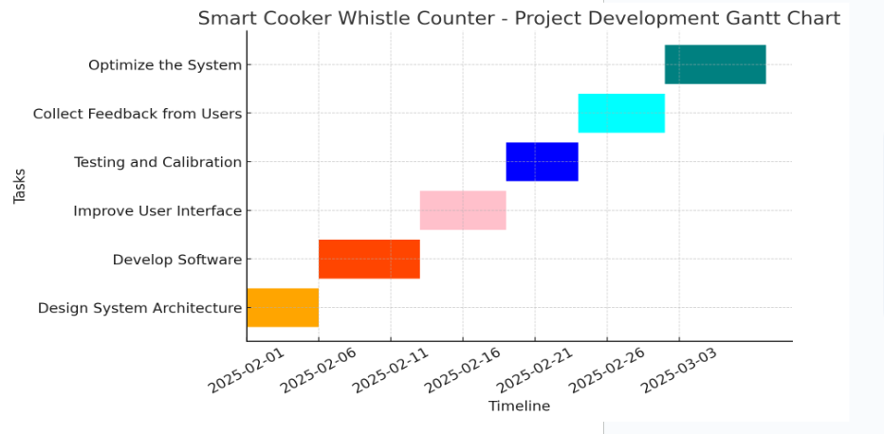

Slide 16
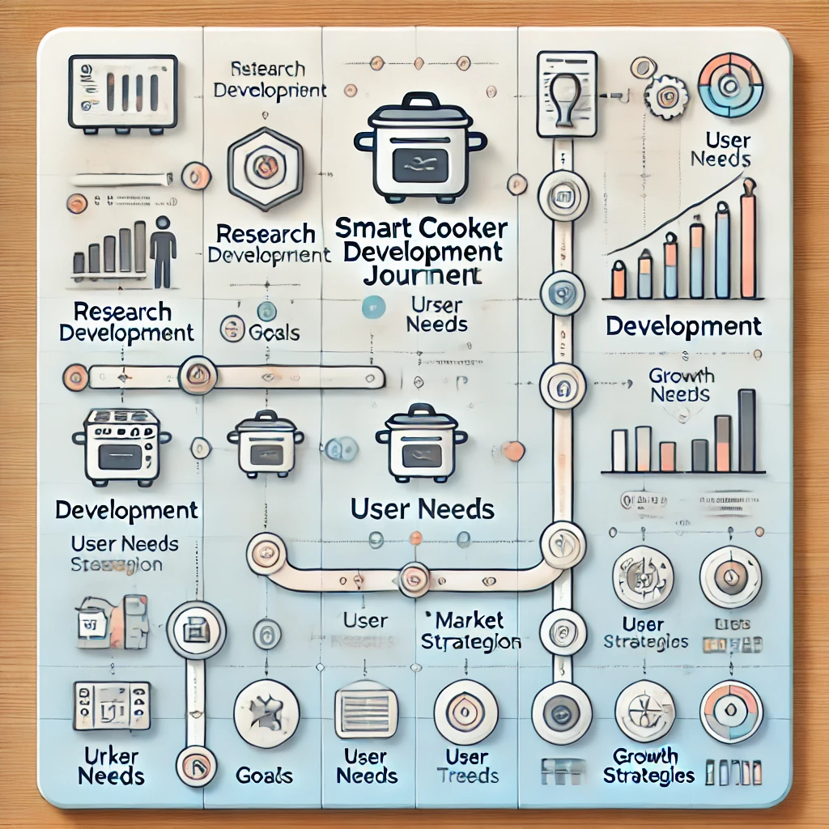

Product Developer Journey

Slide 17
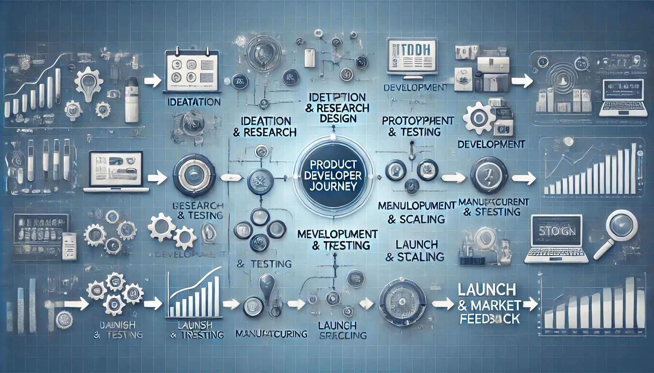

Slide 18
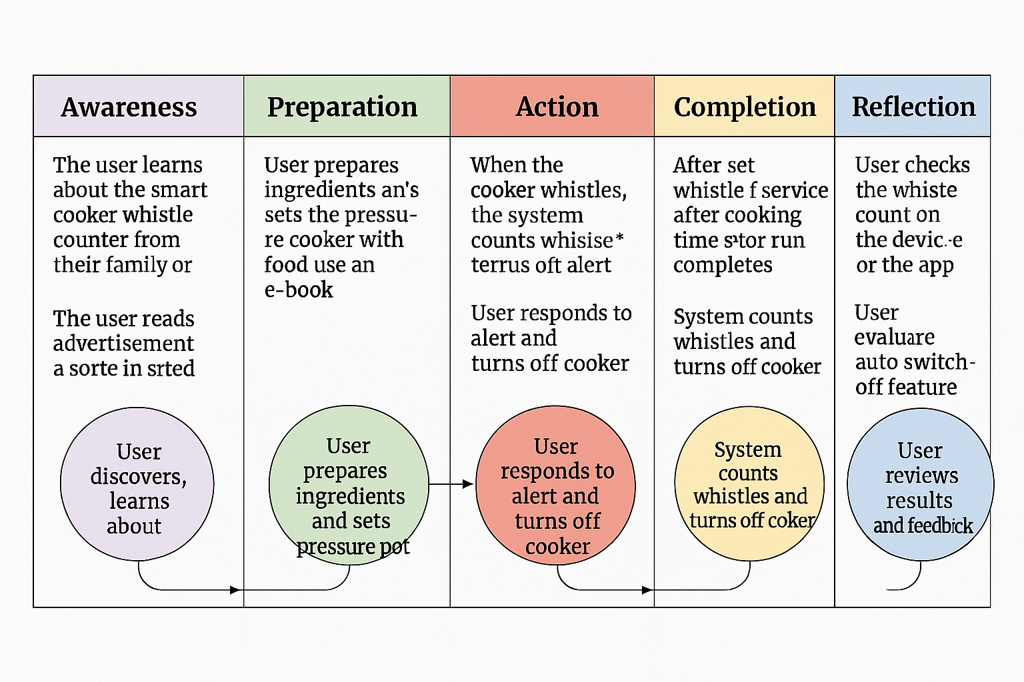

Slide 19
Gap analysis
Existing Market Gaps in Traditional Cooking Solutions
Manual Cooking Challenges:
🔴 Traditional pressure cookers require constant manual supervision, making cooking inconvenient and time-consuming. 🔴 Users often face challenges in counting whistles accurately, leading to inconsistent cooking results and affecting food quality. 🔴 Increased gas or electricity wastage due to the lack of an automatic switch-off feature. 🔴 Safety concerns arise due to the risk of overcooking or overheating in traditional cookers.
Limitations of Existing Smart Cookers:
🟠 High-cost smart cookers make automation inaccessible for many households. 🟠 The market currently offers limited smart cooking solutions that integrate whistle counting technology, leaving a gap in automation for precise cooking. 🟠 Complex user interfaces make them difficult for non-tech-savvy users.
Market Need for an Innovative Solution
✔️ Affordable Smart Cooking – Households and small restaurants seek cost-effective automation. ✔️ Precise & Hassle-Free Cooking – Automated whistle detection ensures consistent results. ✔️ Energy-Efficient & Safe – Auto switch-off prevents overheating, reducing electricity and gas consumption.
Key Opportunity:
A cost-effective, user-friendly, and smart whistle-counting cooker with an auto switch-off feature that automates cooking, enhances safety, reduces energy wastage, and ensures precision without constant supervision.

Slide 20
P - Product (Description, Overview)
Overview of the Smart Cooker Whistle Counter
The Smart Cooker Whistle Counter is an innovative kitchen solution designed to enhance convenience, precision, and safety in pressure cooking. This system automates whistle counting and integrates an auto switch-off feature, ensuring perfectly cooked meals while reducing manual effort and energy consumption.
Key Features:
✅ Automated Whistle Counting – Accurately detects and counts whistles for precise cooking. ✅ Auto Switch-Off – Turns off heat automatically after the required whistles, preventing overcooking. ✅ User-Friendly Interface – Simple controls for easy operation, even for beginners. ✅ Multi-Recipe Compatibility – Supports various cooking settings for different dishes. ✅ Energy Efficiency – Reduces electricity usage by stopping heat at the right time. ✅ Safety Features – Prevents overheating, reducing risks of accidents in the kitchen.

Slide 21
Applications:
🏭 Electrical & Electronics Industry – Cutting wires for circuit boards and electrical panels. ⚙️ Manufacturing & Automation – Mass production of uniform wire lengths. 🔬 DIY & Prototyping – Hobbyists and small businesses needing precision cuts. 🚗 Automotive & Aerospace Wiring – Precision-cut wires for harnesses and electrical systems.
💡 Why Choose the Smart Cooker Whistle Counter?
✅ Hands-Free Cooking – No need for constant supervision; ensures perfect cooking. ✅ Consistent & Precise Results – Automatically counts whistles for accurate cooking. ✅ Enhanced Safety – Prevents overcooking and overheating with an auto switch-off feature. ✅ Energy-Efficient – Reduces gas and electricity usage, saving on utility costs. ✅ User-Friendly & Affordable – Smart automation at a budget-friendly price.

Slide 22
COMPARISON
Criteria | Traditional Pressure Cooker | Smart Cooker Whistle Counter with Auto Switch-Off
Whistle Counting | Manual, prone to errors | Automated and accurate whistle detection
Cooking Monitoring | Requires constant supervision | Hands-free operation with automatic alerts
Cooking Accuracy | Inconsistent, due to manual counting | Consistent and precise cooking results
Safety | Risk of overcooking and overheating | Auto switch-off ensures safe operation
Energy Efficiency | High energy consumption without control | Energy-efficient with automatic switch-off
User Convenience | Time-consuming and inconvenient | User-friendly and hassle-free operation
Technology Integration | No smart features | Advanced whistle counting and automation
Market Availability | Widely available | Limited availability in smart cooking solutions

Slide 23
U - Uniqueness of Your Project
Key Unique Features
🔹 💡 Fully Automated Whistle Detection & Smart Control – No manual counting, ensuring precision. 🔹 ⚙️ Customizable Cooking Settings – Set whistle count preferences for different recipes. 🔹 💰 Affordable & Energy-Efficient Solution – Reduces gas and electricity wastage. 🔹 🛡️ Enhanced Safety with Auto Shut-Off – Prevents overcooking and overheating. 🔹 🌍 Versatile & User-Friendly Design – Suitable for all pressure cookers, making cooking effortless.
The Smart Cooker Whistle Counter with Auto Shut-Off revolutionizes traditional pressure cooking by automating whistle counting and ensuring precise cooking results. It features a microphone sensor for accurate whistle detection, a buzzer for completion alerts, an LCD display, and an auto shut-off mechanism to enhance safety, convenience, and energy efficiency. This smart solution eliminates manual supervision, prevents overcooking, and optimizes resource usage, making cooking effortless and reliable.
Final Thought 💭
With its smart automation, affordability, and precision, the Smart Cooker Whistle Counter with Auto Shut-Off is set to revolutionize pressure cooking, making it more convenient, safe, and efficient for households and cooking enthusiasts alike!

Slide 24
Flow diagram
+---------+ +------------------+ +----------------+ +-----------------+ +----------------------+
| Start |→| Add Ingredients| →| Set Whistle | →| Detect Whistle| → | Auto Shut-Off |
| | | & Water | | Count | | with Sensor | | |
+---------+ +------------------+ +----------------+ +-----------------+ +----------------------+
↓
+------------------+ +------------------+ +-----------------+ +------------+
| Cooking Done | → | Alert with | → | Release Steam| → | End |
| | | Buzzer & LCD | | if Needed | | |
+------------------+ +------------------+ +-----------------+ +------------+

Slide 25

